Slide 1
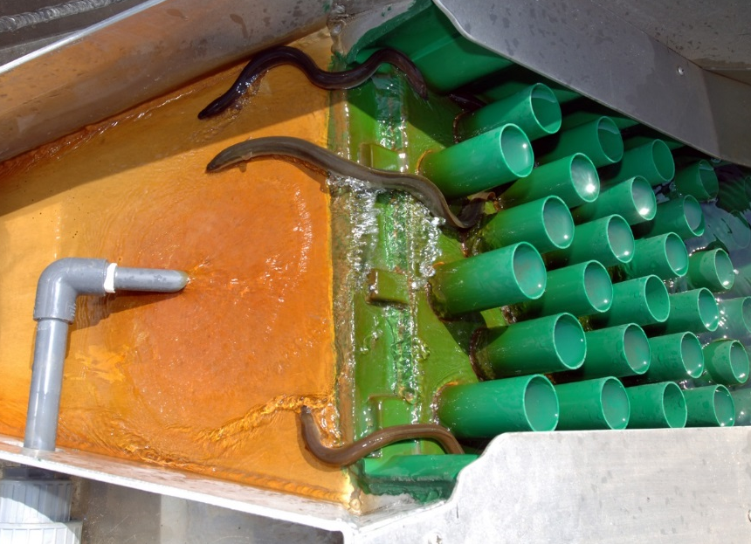
AMERICAN EELS: Reconnecting the mountains to the sea
_______________________________________________________________________________________________________________________
EELS ARE A LARGE MIGRATORY FISH
American eels can migrate over 1,500 miles in fresh and salt water along the Atlantic Coast of North America. They can live to be 30 years old and grow over three feet in length.
EEL POPULATIONS ARE DECREASING
Eels were abundant in the eastern U.S. when European settlers arrived and have since been regarded as a delicacy. Due to high demand, and dwindling supply, young eels are worth up to $2,000 per pound.
VA
American Eel Range
USGS,2017
HOW HAVE WE HELPED?
Eels have been able to migrate back to their native habitats because dams have been removed and eel ladders have assisted them. This inland migration is not only good for the eels, but for these ecosystems as a whole.
NY POWER AUTHORITY
DO EELS AFFECT OTHER FISH?
It appears that eels and other native fish (e.g., brook trout) get along fine and may even increase health of Virginia streams by resisting the invasion of non-native species.
WHAT NOW?
Learn more about how
you can help conserve
American eels;
Contact JON STUDIO; studioja@jmu.edu
In cooperation with James Madison University and Virginia Sea Grant

